Slide 1
Pathfinder Player Tool
Models and Design
David Cindric
Matthew Johnson
02, October 2014
Slide 1

Slide 2
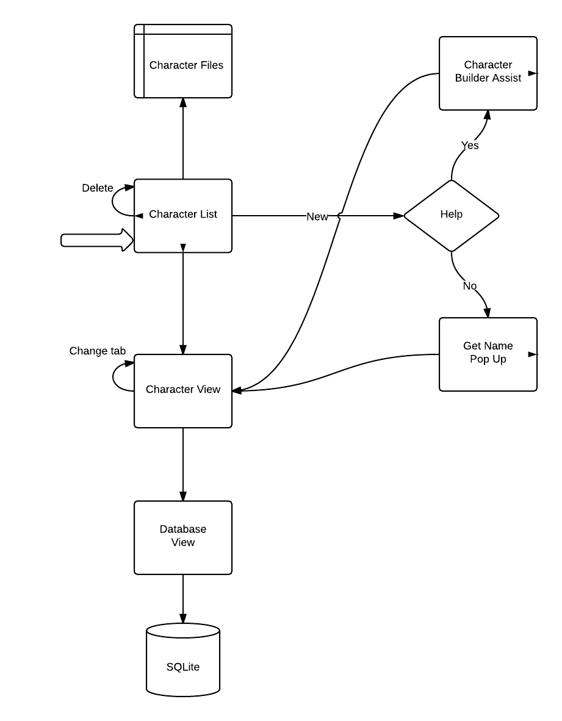
Process Model
Start
Slide 2

Slide 3
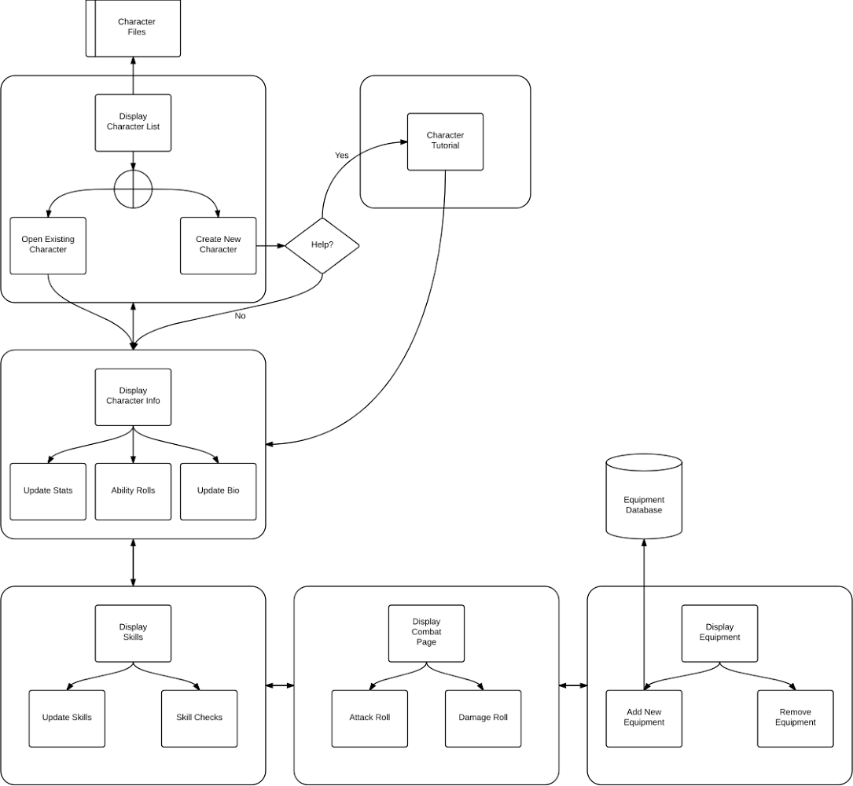
Updated Process Model
Slide 3

Slide 4
Data Model
Slide 4

Slide 5
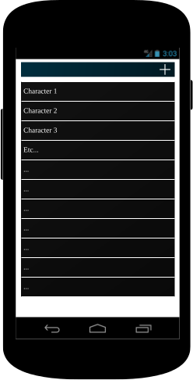
Main Screen
Slide 5

Slide 6
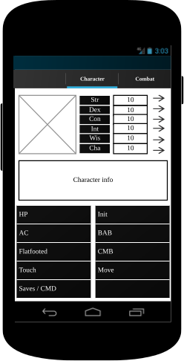
Character
Slide 6

Slide 7
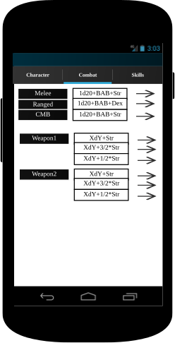
Combat
Slide 7

Slide 8
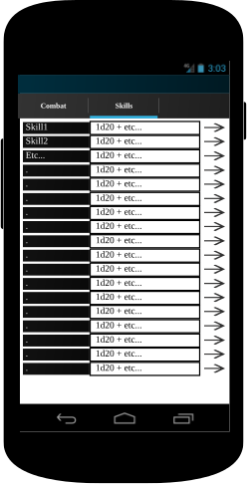
Skills
Slide 8

